Slide 1
Site provisioning techniques with SharePoint App Model
Vesa Juvonen
Senior Program Manager
Microsoft, Office 365

Slide 2

Vesa Juvonen, MCM/MCSM
Senior Program Manager, Microsoft
twitter.com/@vesajuvonen
vesa.juvonen@microsoft.com
App model questions to http://aka.ms/OfficeDevPnPYammer please
Office 365 Dev Patterns and Practices program lead, SharePoint MCM/MCSM instructor, JDP program technical lead, hands on in transition projects for customers and in engineering

Slide 3
Agenda
Hybrid models for site provisioning
Site provisioning patterns
PnP Provisioning Engine
Site provisioning with CSOM

Slide 4
Moving from feature framework based implementation to remote APIs

Slide 5
“Web templates were the best option in SharePoint 2010, what has changed?”
Better remote APIs
Much better remote APIs in 2013 provide us full flexibility on the site provisioning without causing additional maintenance challenges
Notes:
Steve

Slide 6

Maintenance challenge with web templates
Web Template onet.xml is created by copying team site onet.xml and by adding stapled features to the onet.xml
Significant differences on the outcome unless web template onet.xml has been updated cross site collections with the changes which were also done for out of the box team site.
onet.xml
onet.xml
onet.xml
<xml>
X feature activations
<xml>
X feature activations
<xml>
X feature activations
<< Copy >>
Custom Web Template
Team Site
onet.xml
onet.xml
onet.xml
<xml>
X feature activations
<xml>
X feature activations +2
<xml>
X feature activations +4
Time
Service updates for introducing new capabilities to team sites also using feature stapling
Notes:
Vesa
Risk is that for sites created from the time WE updated the service until the time YOU updated your Templates, these sites will NOT have all of the features

Slide 7
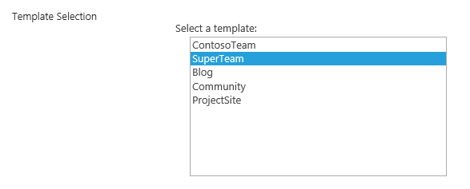
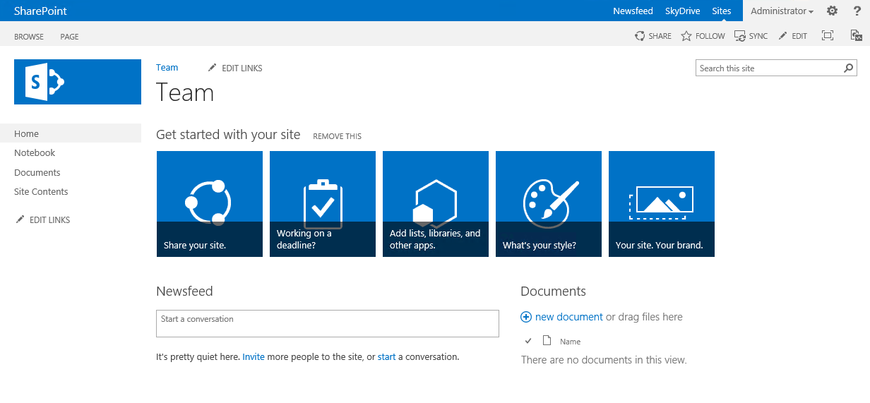
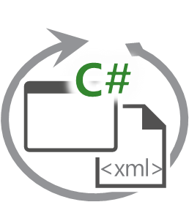
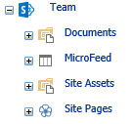
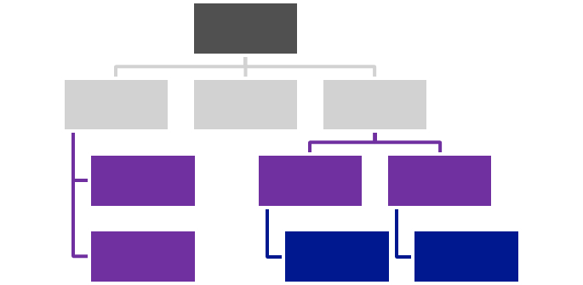

SharePoint Remote Provisioning
SharePoint Service
1
Provider Hosted Apps
3
CSOM / REST
Own app specific configuration
Artefacts
2
Notes:
Steve

Slide 8
“No more feature framework?”
Correct
We recommend remote provisioning patterns rather than feature framework usage
Notes:
Vesa

Slide 9


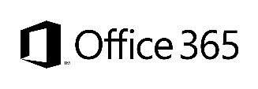
Site Provisioning Options/Comparison
Site Definition
Site Templates
Web Templates
SP Server side provisioning
Remote provisioning
No Office365
Long term impact on costs
Blocks transition to cloud
Causes significant issues with future migration and upgrade
Poor site collection creation story
Negative impact on upgrades
Causes additional maintenance costs with service updates
Not with publishing features
Poor site collection creation story
Causes maintenance costs with service updates
Provision oob sites, but modify them based on user selection and requirements
Standardization of site creation in code
No Office365
CSOM supports creation of site collections for on-premises and cloud
Standardization of site creation in code
Can be done from any external system
Options
Support in cloud
Options available
Good
Fair
Average
Good
Excellent
Cost impact (short and long term)
Notes:
Vesa
For more information on provisioning sites and associated terminology see:
SharePoint 2010 and web templates, http://blogs.msdn.com/b/vesku/archive/2010/10/14/sharepoint-2010-and-web-templates.aspx
Site provisioning techniques and remote provisioning in SharePoint 2013, http://blogs.msdn.com/b/vesku/archive/2013/08/23/site-provisioning-techniques-and-remote-provisioning-in-sharepoint-2013.aspx

Slide 10
Site provisioning with app model

Slide 11

Site Collection Creation from Apps
What
Provision new site collections from app side
Why
Can be used to override out–of–the–box self-service site collection creation form
Can be used to integrate additional functionalities as part of the provisioning
How
Office365 has separate downloadable that includes the needed CSOM elements to provision sites
After 2014 April CU, natively supported for on-prem as well.
Notes:
Vesa

Slide 12
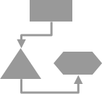
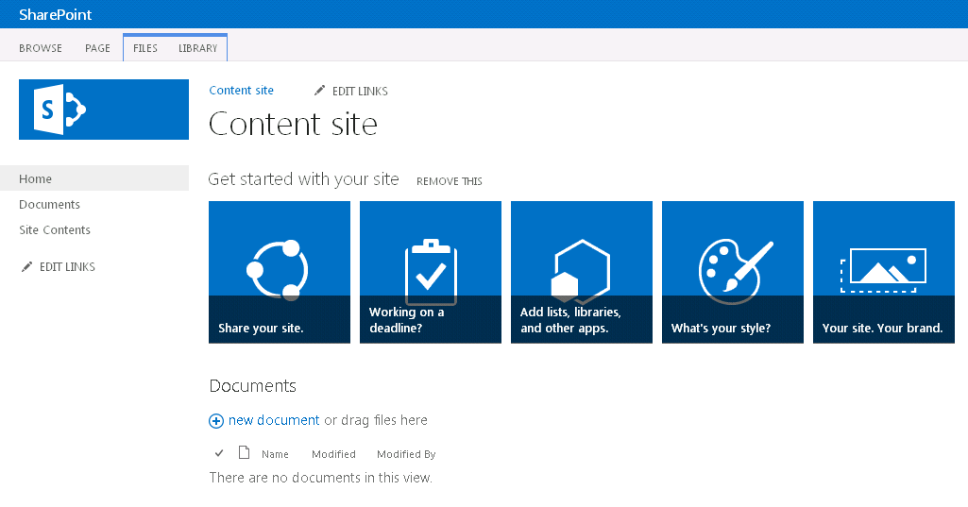
Async provisioning model
Provider Hosted Apps
2
SharePoint Service
1
3
4
6
Remote timer job
5
https://contoso.sharepoint.com /sites/site
Notes:
Vesa

Slide 13
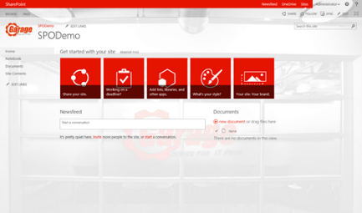
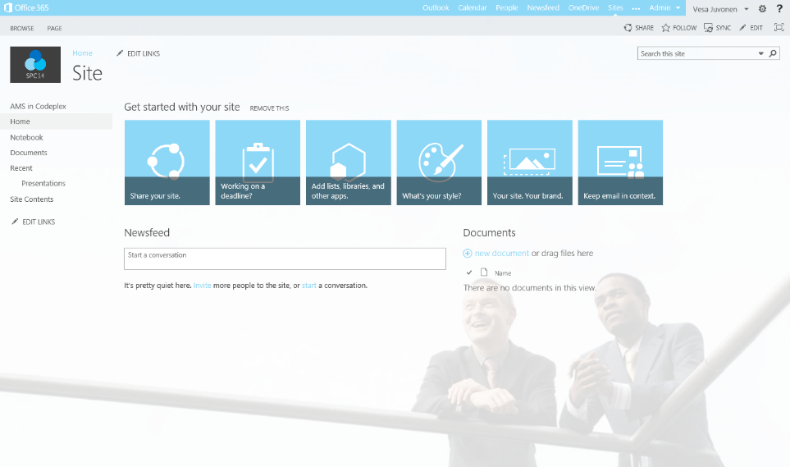
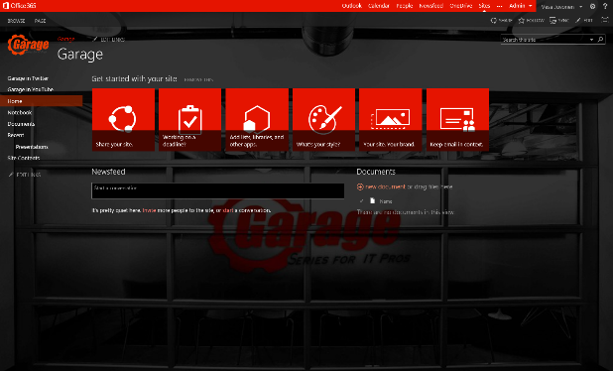
Provisioning time logic
Initial provisioning based on the out of the box site. Usually either team site or publishing site.
Assets are uploaded from the provisioning engine using CSOM/REST
3
Project site
1
2
Remote timer job
3
Assets and configuration
Organizational
Apply the needed changes (configurations etc.) on top of the out of the box site based on the user selection.
This is the specialization part, but since we start from oob site, we always get the latest improvements to it as a base line.
Branding Images
Master Pages
Page Layouts
Other settings
3
Workgroup
Notes:
Vesa

Slide 14
“So, Now I have to write an entire custom Engine for this?”
Not Necessarily
If your model today is to have someone create the site, and then run PowerShell or feature activations, etc.. That is the “Mechanical Turk” of remote site provisioning… still applicable pattern if you should so choose.
Notes:
Steve

Slide 15
Site collection provisioning
Using CSOM to provision site collections
https://github.com/OfficeDev/PnP/tree/master/Samples/Provisioning.SiteCollectionCreation

Slide 16
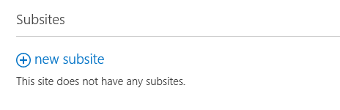
Remote provisioning sub sites
1
SharePoint Service
Provider Hosted Apps
CSOM / REST
3
2
4
Own app specific configuration
Artefacts
Notes:
Steve

Slide 17
Sub site provisioning
Overriding out of the box sub site creation expirience and take ownership of the site provisioning
https://github.com/OfficeDev/PnP/tree/master/Samples/Provisioning.SubSiteCreationApp

Slide 18
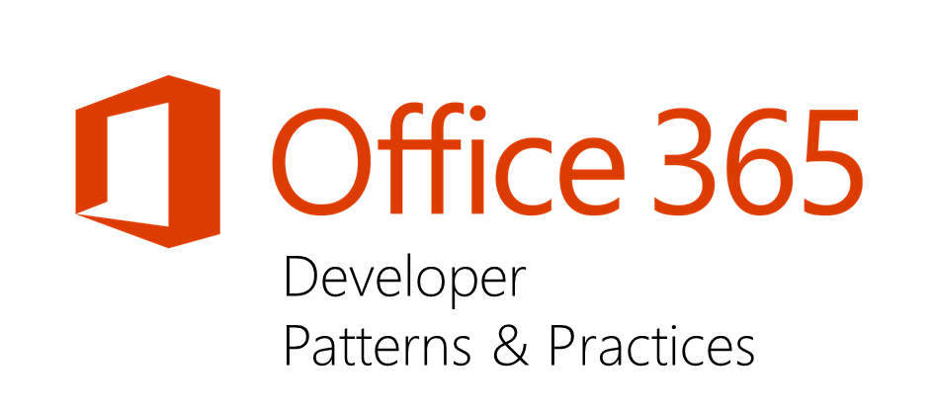
PnP provisioning engine

Slide 19
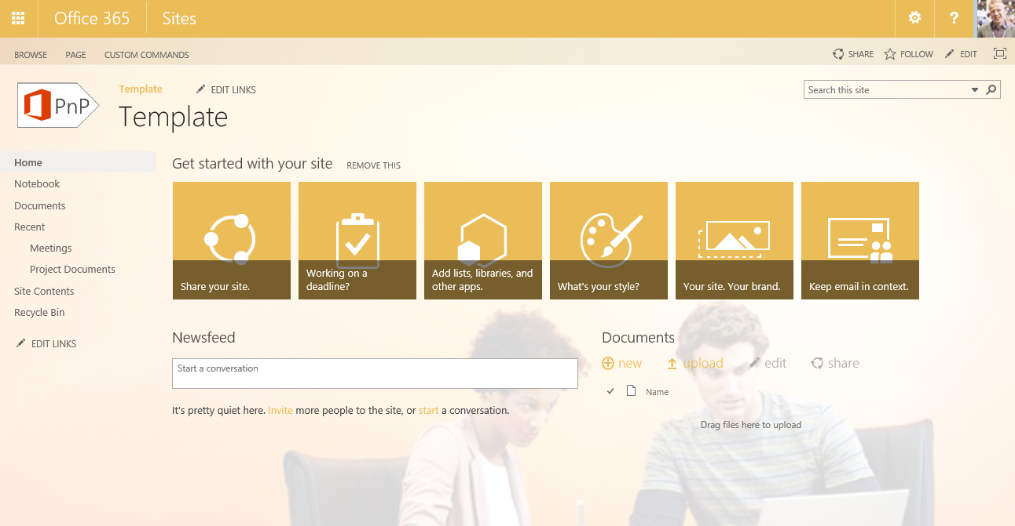
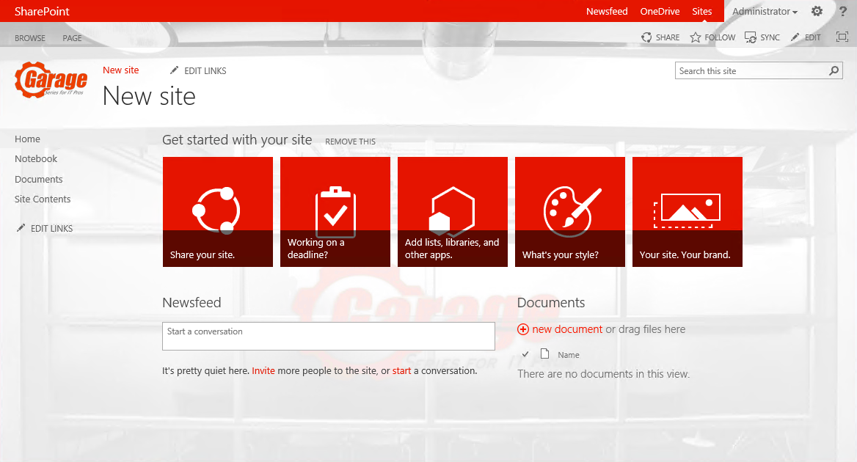
Business user driven templates
Modify with browser
1
2
3
Extract template
Template sites
Provider Hosted App
Provisioning engine
SharePoint Service
4
5
Template details are being extracted from actual template sites during provisioning.
Templates can be modified and crated using browser UI and all changes are reflected to the newly created and potentially modified sites.
https://contoso.sharepoint.com /sites/site

Slide 20

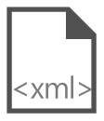
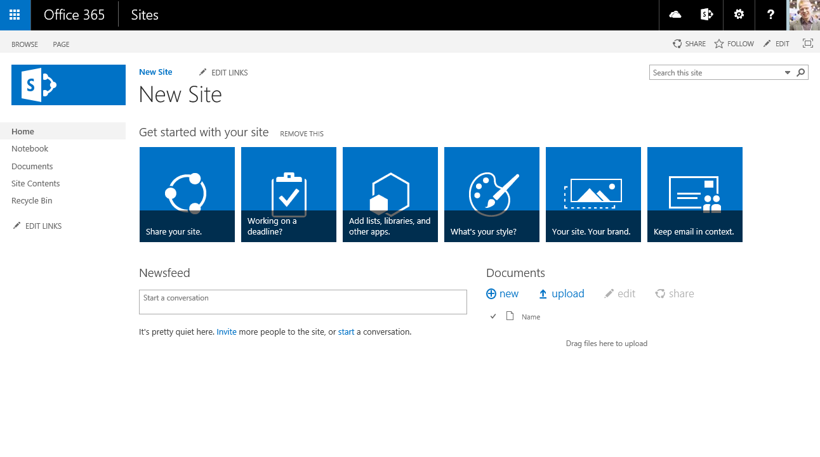
Site provisioning framework
C#
1
// Get template from existing site
template = ctx.Web.GetProvisioningTemplate();
Site A
XMLFileSystemTemplateProvider
2
// Save template using XML provider
XMLFileSystemTemplateProvider provider =
new XMLFileSystemTemplateProvider(@"c:\temp\", "");
string templateName = "template.xml";
provider.SaveAs(template, templateName);
// Load the saved model again
ProvisioningTemplate p2 =
provider.GetTemplate(templateName);
Connectors
3
XMLAzureStorageTemplateProvider
4
Site B
XMLSharePointTemplateProvider
// Apply template to existing site
ctxTarget.Web.ApplyProvisioningTemplate(template);

Slide 21
PnP Provisioning engine
Hosting provider hosted app in Azure and provision sites to on-premises SharePoint deployment
Today at http://github.com/OfficeDev/PnP...

Slide 22
Hybrid patterns for provisioning

Slide 23
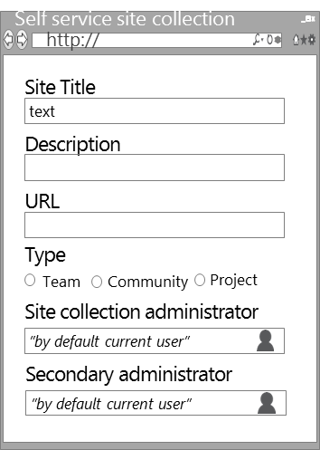
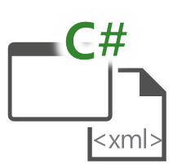
Hybrid self service pattern – classic
Contoso
Internal Users
SharePoint Service
3
1
Provider hosted Apps
http://contoso.sharepoint.com/sites/site
2
Operations are driven from the on-premises.
Integration to cloud is pretty simple with the tenant CSOM.
http://teams.contoso.com/sites/site

Slide 24
Cloud driven hybrid
Contoso
SharePoint Service
Users
2
1
http://contoso.sharepoint.com/sites/site
http://teams.contoso.com/sites/site
Provider Hosted Apps
4
Operations are driven from the cloud.
Connectivity from cloud to on-premises using service bus.
Service Bus
3

Slide 25
Provision sites to on-prem from Azure
Hosting provider hosted app in Azure and provision sites to on-premises SharePoint deployment
https://github.com/OfficeDev/PnP/tree/master/Samples/Provisioning.Hybrid.Simple

Slide 26
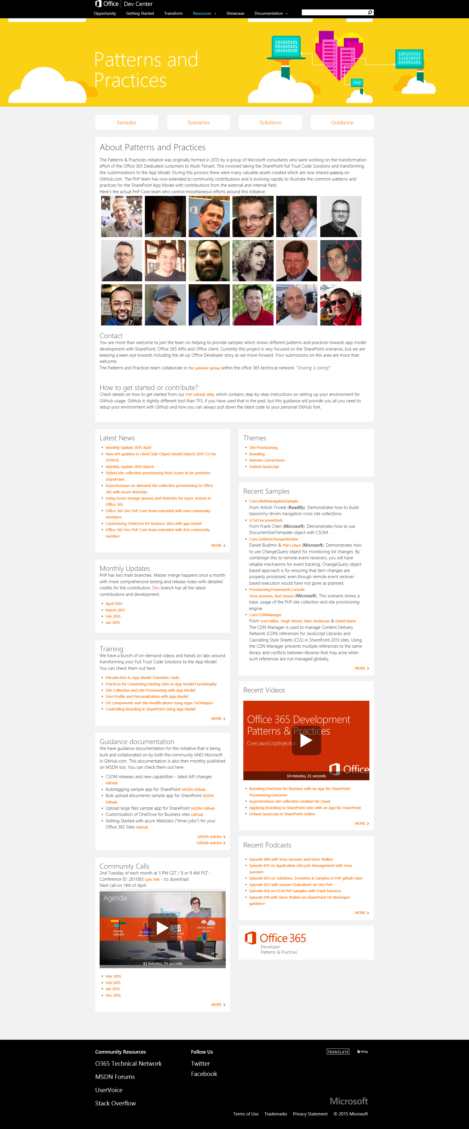
“Sharing is caring”
aka.ms/OfficeDevPnP
aka.ms/OfficeDevPnPYammer
aka.ms/OfficeDevPnPMSDN
aka.ms/OfficeDevPnPVideos
aka.ms/OfficeDevPnPTraining

Slide 27
Thank you for attending!
Vesa Juvonen

